Slide 1
Core Java

Slide 2

Agenda
Arrays
String
String Buffer
StringBuilder

Slide 3
Arrays
Normally, an array is a collection of similar type of elements which has contiguous memory location.
Arrays are used to store multiple values in a single variable, instead of declaring separate variables for each value.
Java array is an object which contains elements of a similar data type. Additionally, The elements of an array are stored in a contiguous memory location. It is a data structure where we store similar elements. We can store only a fixed set of elements in a Java array.
Array in Java is index-based, the first element of the array is stored at the 0th index, 2nd element is stored on 1st index and so on.
To declare an array, define the variable type with square brackets:
String[] cars;
We have now declared a variable that holds an array of strings. To insert values to it, you can place the values in a comma-separated list, inside curly braces:
String[] cars = {"Volvo", "BMW", "Ford"};

Slide 4
Arrays
Arrays in Java
In Java, all arrays are dynamically allocated. (discussed below)
Arrays may be stored in contiguous memory [consecutive memory locations].
Since arrays are objects in Java, we can find their length using the object property length. This is different from C/C++, where we find length using sizeof.
A Java array variable can also be declared like other variables with [] after the data type.
The variables in the array are ordered, and each has an index beginning with 0.
Java array can also be used as a static field, a local variable, or a method parameter.

Slide 5
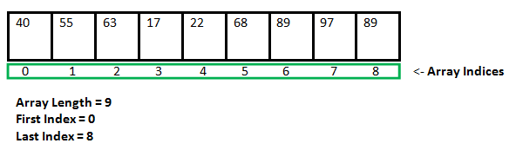
Java
An array can contain primitives (int, char, etc.) and object (or non-primitive) references of a class depending on the definition of the array. In the case of primitive data types, the actual values might be stored in contiguous memory locations(JVM does not guarantee this behavior). In the case of class objects, the actual objects are stored in a heap segment.

Slide 6
Java
Creating, Initializing, and Accessing an Arrays
One-Dimensional Arrays
The general form of a one-dimensional array declaration is
-- type var-name[];
-- type[] var-name;
An array declaration has two components: the type and the name. type declares the element type of the array. The element type determines the data type of each element that comprises the array. Like an array of integers, we can also create an array of other primitive data types like char, float, double, etc., or user-defined data types (objects of a class). Thus, the element type for the array determines what type of data the array will hold.

Slide 7
Java
Instantiating an Array in Java
When an array is declared, only a reference of an array is created. To create or give memory to the array, you create an array like this: The general form of new as it applies to one-dimensional arrays appears as follows:
var-name = new type [size];
Here, type specifies the type of data being allocated, size determines the number of elements in the array, and var-name is the name of the array variable that is linked to the array. To use new to allocate an array, you must specify the type and number of elements to allocate.
//declaring array
int intArray[];
// allocating memory to array
intArray = new int[20];
// combining both statements in one
int[] intArray = new int[20];

Slide 8
Java
Note: The elements in the array allocated by new will automatically be initialized to zero (for numeric types), false (for boolean), or null (for reference types). Do refer to default array values in Java.
S. No. | Datatype | Default Value
1 | boolean | false
2 | int | 0
3 | double | 0.0
4 | String | null
5 | User-Defined Type | null

Slide 9
Java
Array Literal in Java
In a situation where the size of the array and variables of the array are already known, array literals can be used.
// Declaring array literal
int[] intArray = new int[]{ 1,2,3,4,5,6,7,8,9,10 };
The length of this array determines the length of the created array.
There is no need to write the new int[] part in the latest versions of Java.
Accessing Java Array Elements using for Loop
// accessing the elements of the specified array
for (int i = 0; i < arr.length; i++)
System.out.println("Element at index " + i + " : "+ arr[i]);

Slide 10
Java
What happens if we try to access elements outside the array size?
JVM throws ArrayIndexOutOfBoundsException to indicate that the array has been accessed with an illegal index. The index is either negative or greater than or equal to the size of an array.
Multidimensional Arrays can be defined in simple words as array of arrays. Data in multidimensional arrays are stored in tabular form (in row major order).
data_type[1st dimension][2nd dimension][]..[Nth dimension] array_name = new data_type[size1][size2]….[sizeN];
data_type: Type of data to be stored in the array. For example: int, char, etc.
dimension: The dimension of the array created. For example: 1D, 2D, etc.
array_name: Name of the array
size1, size2, …, sizeN: Sizes of the dimensions respectively.

Slide 11
Java
Two dimensional array:
int[][] twoD_arr = new int[10][20];
Three dimensional array:
int[][][] threeD_arr = new int[10][20][30];
Size of multidimensional arrays: The total number of elements that can be stored in a multidimensional array can be calculated by multiplying the size of all the dimensions.
For example: The array int[][] x = new int[10][20] can store a total of (10*20) = 200 elements. Similarly, array int[][][] x = new int[5][10][20] can store a total of (5*10*20) = 1000 elements.
Application of Multi-Dimensional Array
Multidimensional arrays are used to store the data in a tabular form. For example, storing the roll number and marks of a student can be easily done using multidimensional arrays. Another common usage is to store the images in 3D arrays.
Apart from these, they also have applications in many standard algorithmic problems like: Matrix Multiplication, Adjacency matrix representation in graphs, Grid search problems

Slide 12
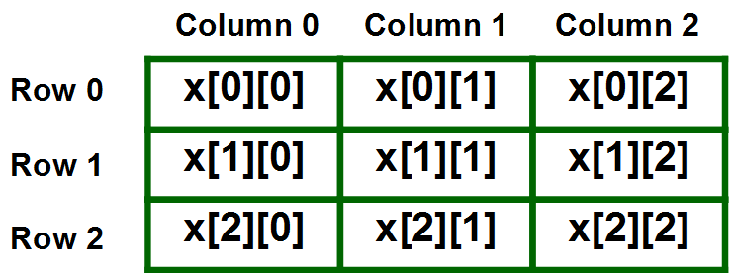
Java
A two – dimensional array can be seen as a table with ‘x’ rows and ‘y’ columns where the row number ranges from 0 to (x-1) and column number ranges from 0 to (y-1). A two – dimensional array ‘x’ with 3 rows and 3 columns is shown below:

Slide 13
Java
The string is a sequence of characters. In Java, objects of String are immutable which means a constant and cannot be changed once created.
Creating a String
There are two ways to create string in Java:
1) String literal
String s = “Hello”;
2) Using new keyword
String s = new String (“Hello”);
Strings are the type of objects that can store the character of values and in Java, every character is stored in 16 bits i,e using UTF 16-bit encoding. A string acts the same as an array of characters in Java.

Slide 14
Java
What is Java String Pool?
A Java String Pool is a place in heap memory where all the strings defined in the program are stored. A separate place in a stack is there where the variable storing the string is stored. Whenever we create a new string object, JVM checks for the presence of the object in the String pool, If String is available in the pool, the same object reference is shared with the variable, else a new object is created.
String s1 = "abc";
String s2 = "abc";
// Note that this == compares whether
// s1 and s2 refer to same object or not
if (s1 == s2)
System.out.println("Yes");
else
System.out.println("No");

Slide 15
Java
String s1 = new String("abc");
String s2 = new String("abc");
// Note that this == compares whether
// s1 and s2 refer to same object or not
if (s1 == s2)
System.out.println("Yes");
else
System.out.println("No");

Slide 16
Java
The String is a sequence of characters. One of the most important characteristics of a string in Java is that they are immutable. In other words, once created, the internal state of a string remains the same throughout the execution of the program. This immutability is achieved through the use of a special string constant pool in the heap. In this article, we will understand about the storage of the strings. A string constant pool is a separate place in the heap memory where the values of all the strings which are defined in the program are stored. When we declare a string, an object of type String is created in the stack, while an instance with the value of the string is created in the heap. On standard assignment of a value to a string variable, the variable is allocated stack, while the value is stored in the heap in the string constant pool. For example, let’s assign some value to a string str1.
How String Pool Works?
String str1 = "Hello";

Slide 17
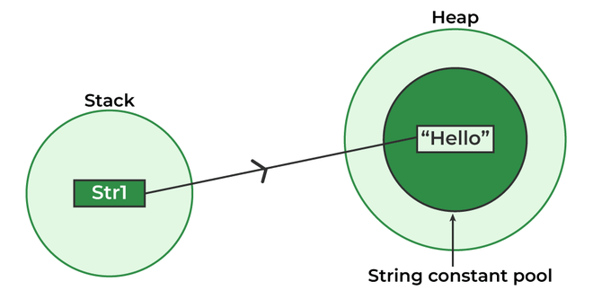
Java

Slide 18
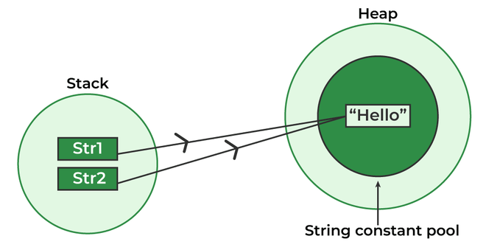
Java
In the above scenario, a string object is created in the stack, and the value “Hello” is created and stored in the heap. Since we have normally assigned the value, it is stored in the constant pool area of the heap. A pointer points towards the value stored in the heap from the object in the stack. Now, let’s take the same example with multiple string variables having the same value as follows:
String str1 = "Hello";
String str2 = "Hello";

Slide 19
Java
One way to skip this memory allocation is to use the new keyword while creating a new string object. The ‘new’ keyword forces a new instance to always be created regardless of whether the same value was used previously or not. Using ‘new’ forces the instance to be created in the heap outside the string constant pool which is clear, since caching and re-using of instances isn’t allowed here.

Slide 20
Java
StringBuffer is a class in Java that represents a mutable sequence of characters. It provides an alternative to the immutable String class, allowing you to modify the contents of a string without creating a new object every time.
Here are some important features and methods of the StringBuffer class:
StringBuffer objects are mutable, meaning that you can change the contents of the buffer without creating a new object.
The initial capacity of a StringBuffer can be specified when it is created, or it can be set later with the ensureCapacity() method.
The append() method is used to add characters, strings, or other objects to the end of the buffer.
The insert() method is used to insert characters, strings, or other objects at a specified position in the buffer.
The delete() method is used to remove characters from the buffer.
The reverse() method is used to reverse the order of the characters in the buffer.

Slide 21
Java
StringBuffer sb = new StringBuffer();
sb.append("Hello");
sb.append(" ");
sb.append("world");
String message = sb.toString();
System.out.println(message);
Output : Hello world
Advantages :
Mutable: StringBuffer objects are mutable, which means that you can modify the contents of the object after it has been created. In contrast, String objects are immutable, which means that you cannot change the contents of a String once it has been created.
Efficient: Because StringBuffer objects are mutable, they are more efficient than creating new String objects each time you need to modify a string. This is especially true if you need to modify a string multiple times, as each modification to a String object creates a new object and discards the old one.

Slide 22
Java
Thread-safe: StringBuffer objects are thread-safe, which means multiple threads can access it simultaneously( they can be safely accessed and modified by multiple threads simultaneously). In contrast, String objects are not thread-safe, which means that you need to use synchronization if you want to access a String object from multiple threads.
Overall, if you need to perform multiple modifications to a string, or if you need to access a string from multiple threads, using StringBuffer can be more efficient and safer than using regular String objects.
StringBuffer is a peer class of String that provides much of the functionality of strings. The string represents fixed-length, immutable character sequences while StringBuffer represents growable and writable character sequences. StringBuffer may have characters and substrings inserted in the middle or appended to the end. It will automatically grow to make room for such additions and often has more characters preallocated than are actually needed, to allow room for growth.
Methods:
append,insert,replace,delete,reverse

Slide 23
Java
StringBuilder in Java represents a mutable sequence of characters. Since the String Class in Java creates an immutable sequence of characters, the StringBuilder class provides an alternative to String Class, as it creates a mutable sequence of characters. The function of StringBuilder is very much similar to the StringBuffer class, as both of them provide an alternative to String Class by making a mutable sequence of characters. However, the StringBuilder class differs from the StringBuffer class on the basis of synchronization. The StringBuilder class provides no guarantee of synchronization whereas the StringBuffer class does. Therefore this class is designed for use as a drop-in replacement for StringBuffer in places where the StringBuffer was being used by a single thread (as is generally the case). Where possible, it is recommended that this class be used in preference to StringBuffer as it will be faster under most implementations. Instances of StringBuilder are not safe for use by multiple threads. If such synchronization is required then it is recommended that StringBuffer be used. String Builder is not thread-safe and high in performance compared to String buffer.

Slide 24

Thank you

